Slide 1
Function-Oriented Metrics
In 1977, A.J. Albrecht of IBM developed a method of software metrics based on functionality. He called it the function point.
Based of FP measure of software many other metrics can be computed
Error/FP
$/FP
Defects/FP
Pages of documentation/FP
Errors/PM
Productivity = FP/PM (Effort is measured in person-months)
$/Page of Documentation
LOCs of an applications can be estimated from FP, they are interconvertible.
This process known as Backfiring.
Example: 1 FP = 100 lines of COBOL code

Slide 2
Function-Oriented Metrics
Count no. of External Inputs (EI)
Count no. of External Outputs (EO)
Count no. of External Inquiries (EQ)
Count no. of Internal Logical Files (ILF)
Count no. of External Interface Files (EIF)

Slide 3
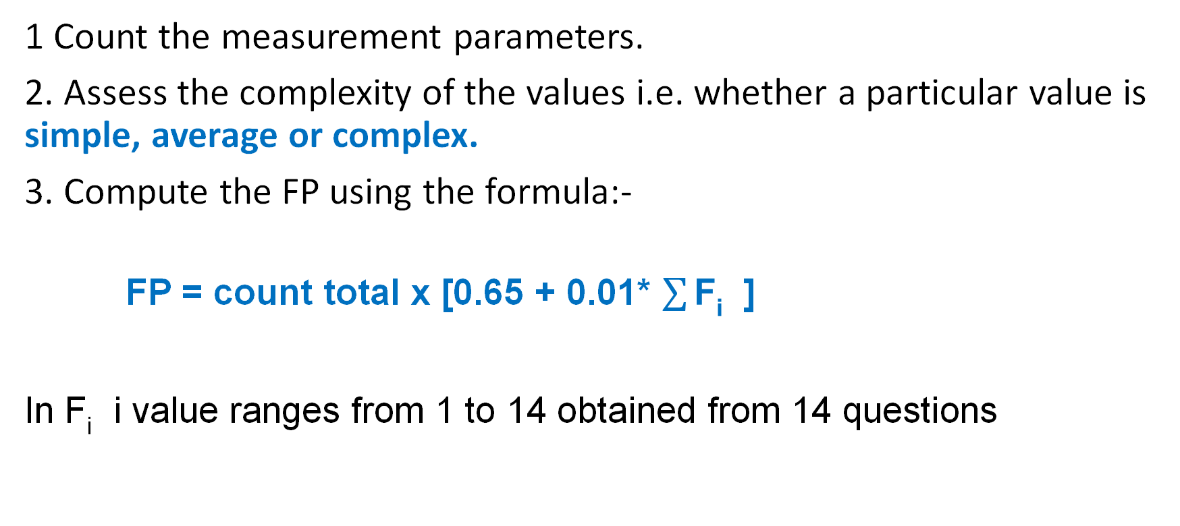
Steps In Calculating FP
1 Count the measurement parameters.
2. Assess the complexity of the values i.e. whether a particular value is simple, average or complex.
3. Compute the FP using the formula:-
FP = count total x [0.65 + 0.01* $\sum{\text{F}\text{i}}$ ]
In F_{i} i value ranges from 1 to 14 obtained from 14 questions

Slide 4
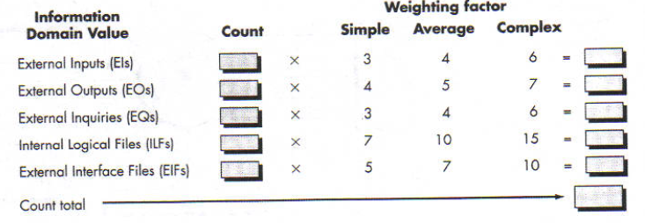
Function Oriented Metrics

Slide 5
Value adjustment Factors
Does the system require reliable backup and recovery?
Are data communications required?
Are there distributed processing functions?
Is performance critical?
Will the system run in an existing, heavily utilized operational environment?
Does the system require on-line data entry?
Does the on-line data entry require the input transaction to be built over multiple screens or operations?
Are the master files updated on-line?
Are the inputs, outputs, files, or inquiries complex?
Is the internal processing complex?
Is the code designed to be reusable?
Are conversion and installation included in the design?
Is the system designed for multiple installations in different organizations?
Is the application designed to facilitate change and ease of use by the user?

Slide 6
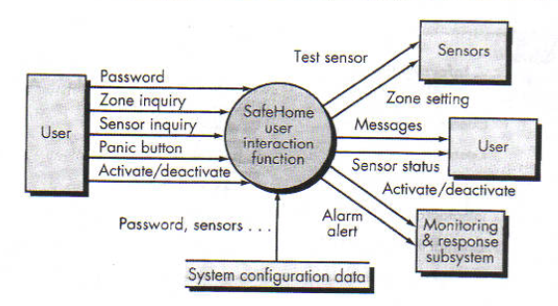
Example:-
Q) Consider a Safe Home System given below:
Calculate the Function Point.

Slide 7
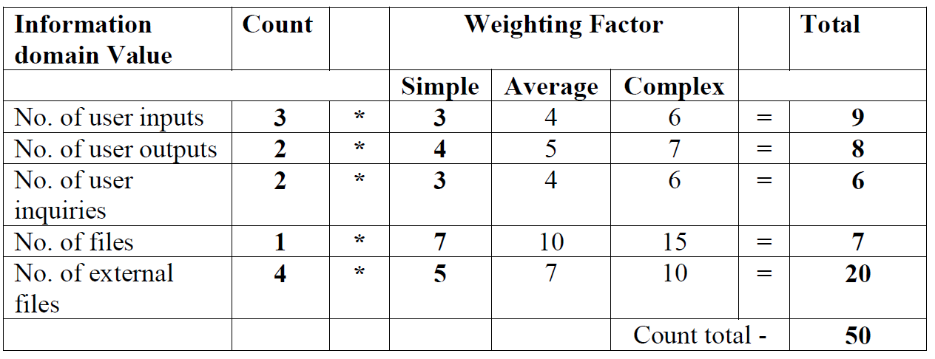
Solution:
Step-1
For a Safe Home System, the Weighting Factor is assumed to be Simple
This is unadjusted function point

Slide 8
Step -2
Assign values to the 14 questions on a scale of 0 to 5.
1. Backup & Recovery =4
2. Data communications=2
3. Distributed Processing=2
4. Performance Critical=4
5. Existing Operating Environment=4
6. Online Data entry=3
7. Input transaction over multiple screens=2
8. Master Files updated Online=5
9. Information domain values Complex=3
10. Internal Processing Complex=3
11. Code designed for reuse=3
12. Conversion/Installation in design=4
13. Multiple Installations=4
14. Application designed for change=3
Total value adjustment factor=Σ Fi=46

Slide 9
Step-3
FP=count total * [ 0.65 + 0.01 * Σfi ]
=50 * [0.65+0.01*46]
=50 * [0.65+0.46]
=50 * 1.11
=55.5
=56 (FP is always rounded off to nearest integer value)

Slide 10
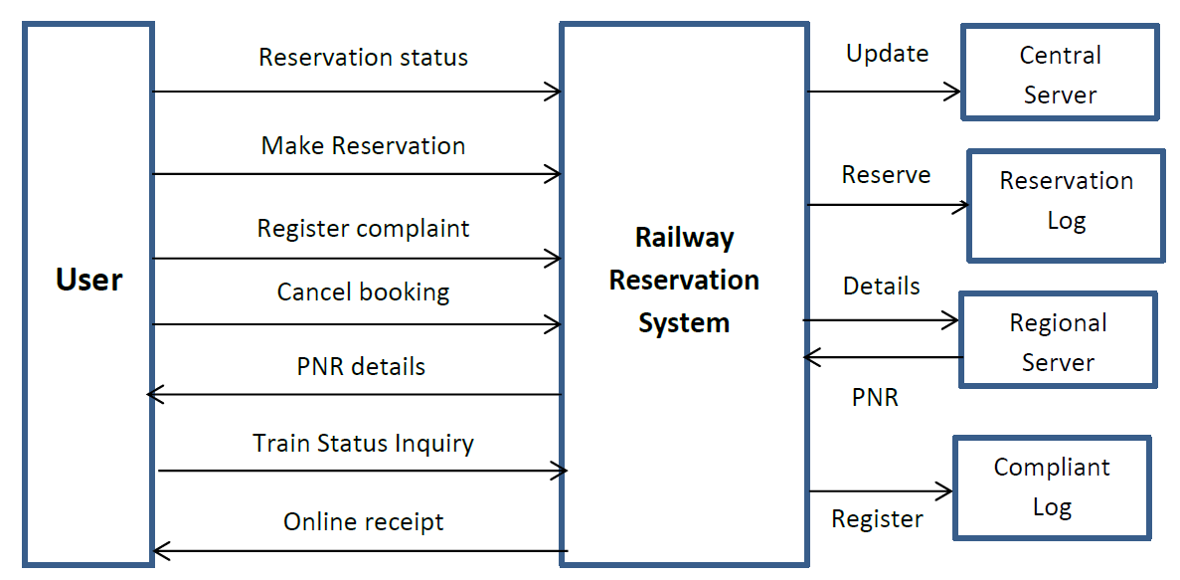
Example 2: Consider a Railway Reservation System given below:
Calculate the Function Point.

Slide 11
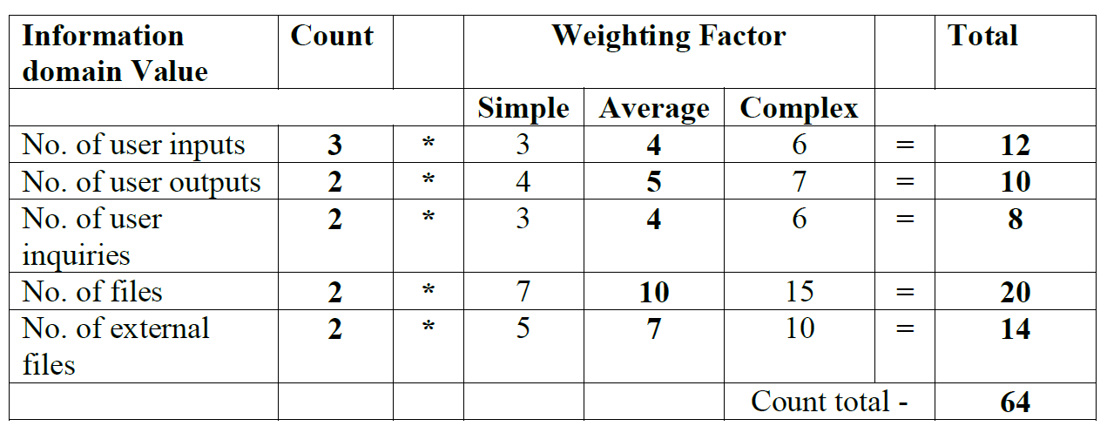
Solution:-
Step-1
For a Railway Reservation System, the Weighting Factor is assumed to be Average
Average

Slide 12
Step -2
Assign values to the 14 questions on a scale of 0 to 5.
1. Backup & Recovery =5
2. Data communications=4
3. Distributed Processing=4
4. Performance Critical=4
5. Existing Operating Environment=3
6. Online Data entry=3
7. Input transaction over multiple screens=4
8. Master Files updated Online=3
9. Information domain values Complex=2
10. Internal Processing Complex=3
11. Code designed for reuse=4
12. Conversion/Installation in design=5
13. Multiple Installations=3
14. Application designed for change=3
Total value adjustment factor=Σ Fi=50

Slide 13
Step-3
FP=count total * [ 0.65 + 0.01 * Σfi ]
=64 * [ 0.65 + 0.01 * 50 ]
=64 * [ 0.65 + 0.5 ]
=64 * 1.15
=73.6
=74

Slide 14
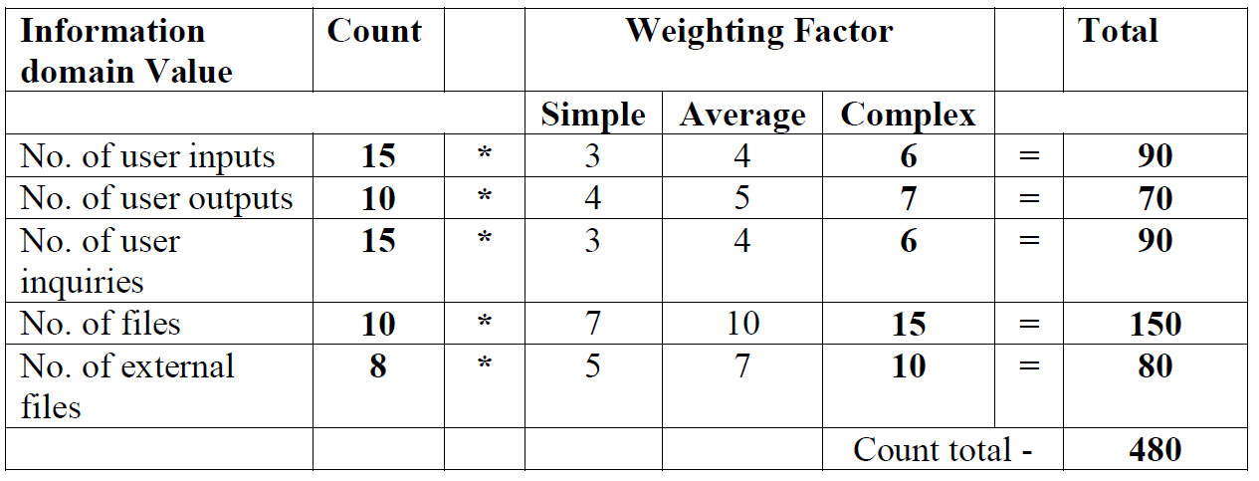
Example 3: Find Function Point for a complex system and calculate the Cost and Effort for the given system. Given Labour rate is $7000 per person-month and Cost per Function Point is $1500.
No. of user inputs 15
No. of user outputs 10
No. of user inquiries 15
No. of files 10
No. of external files 8
Solution:- Step-1 : The Weighting Factor is assumed to be Complex

Slide 15
Step -2
Assign values to the 14 questions on a scale of 0 to 5.
1. Backup & Recovery =5
2. Data communications=5
3. Distributed Processing=5
4. Performance Critical=4
5. Existing Operating Environment=5
6. Online Data entry=3
7. Input transaction over multiple screens=3
8. Master Files updated Online=4
9. Information domain values Complex=5
10. Internal Processing Complex=4
11. Code designed for reuse=4
12. Conversion/Installation in design=5
13. Multiple Installations=5
14. Application designed for change=5
Total value adjustment factor=Σ Fi=62

Slide 16
Step-3
FP=count total*[0.65+0.01*ΣFi]
=480*[0.65+0.01*62]
=480*[0.65+0.62]
=480*1.27
=609.6
=610
Step-4
Cost=FP* Cost Per Function Point
Total estimated cost = 610*1500
=$915000
Effort=Estimated Cost/Labour Rate
Total estimated effort=915000/7000
=130.71
=131 person months

Slide 17
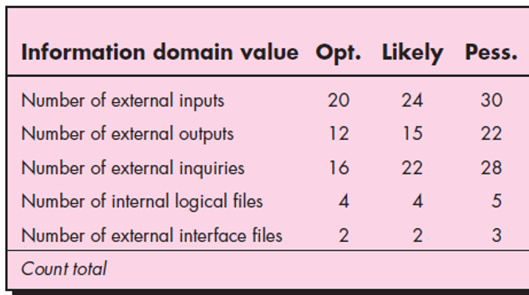
FP based Estimation-example
Calculate FP for a system, on the basis of following information
S= (S_{opt}+4S_{m}+S_{pess})/6

Slide 18
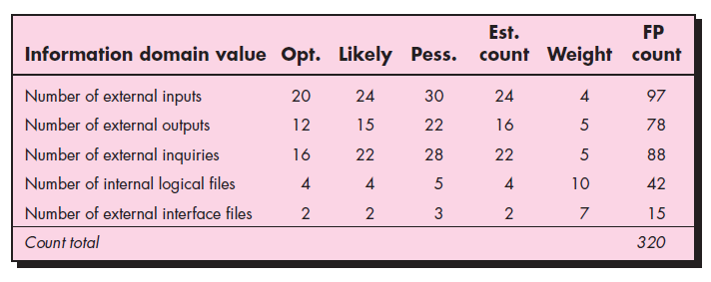
FP based Estimation-example
Solution
S= (S_{opt}+4S_{m}+S_{pess})/6

Slide 19
FP based Estimation-example
FP = count total x [0.65 + 0.01 x summation of F_{i}]
In F_{i} i value ranges from 1 to 14 obtained from 14 questions

Slide 20
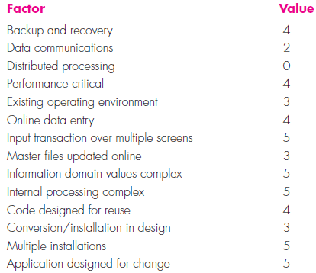
FP based Estimation-example
Total = 52

Slide 21
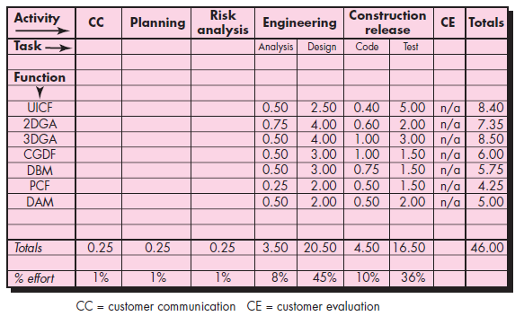
Process based Estimation

Slide 22
Process-Based Estimation
Use-Case Based Estimation

Slide 23
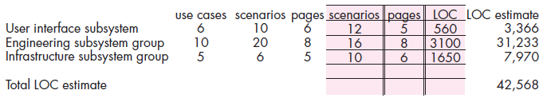
Process based Estimation-example (use case based)
Historical data or
Average Data
Actual Data

Slide 24
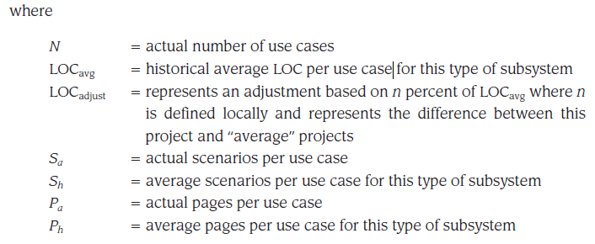
Use case based Estimation-example

Slide 25
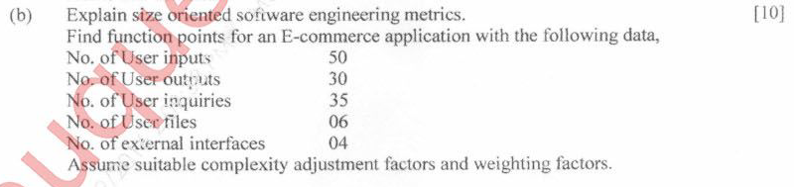
a) Differentiate between FP based & LOC based cost estimation techniques. (10)

